Slide 1
Properties of natural numbers
Nathan hall
Rohan Saha

Slide 2
Common Tests to Find Characteristics of Natural Numbers
Fibonacci Numbers - Selfridge’s Conjecture Lucas Numbers - Baillie-PSW Exponentiation - Fermat’s Little Theorem (FLT), Selfridge, Baillie-PSW Factorials - Wilson’s Theorem Mod 4 - Gaussian Factorization Mod 5 - Selfridge Mod 6 - General Arithmetic Property Mod p - Wilson, Baillie-PSW, FLT

Slide 3
Other Attributes Used
Highly Composite Prime Factors Unique Divisors Powerful Pronic / “Rectangular” Squarefree

Slide 4
General Arithmetic Property:
For all primes > 3 p congruent +/- 1 mod 6
Wilson’s Theorem:
(p – 1)! congruent 1 mod p
Selfridge’s Conjecture:
Given p = 2k + 1 and p congruent +/- 2 mod 5. If 2^(p-1) congruent 1 mod p and f_(p+1) congruent 0 mod p,then p is prime
*Open Problem
Baillie-PSW:
Same as Selfridge’s Conjecture, but substitute Lucas numbers for Fibonacci numbers.
Fermat’s Little Theorem:
a^(n-1) congruent 1 mod n

Slide 5
Future Attributes to Analyze:
More bases for Fermat’s Little Theorem Coprimes Members of Curves and Intersections of Sack’s Spiral Diagonals of Ulam’s Spiral Attributes of Lenstra’s Elliptic Curve Factorization

Slide 6
Goals for Future Work
To see if a set of n attributes can achieve a high accuracy of predicting prime/compositeness of a given number.
Find a novel set of attributes to find primes/pseudoprimes.
Find if a subset of primes can be reliably identified. Find a correlation between different spiral, or spiral like, organizations of natural numbers and the probability of being prime. i.e. prime density If so, attempt to use Genetic Programming to see if progress can be made on the Twin Prime Conjecture.

Slide 7
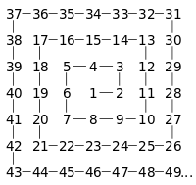

Slide 8
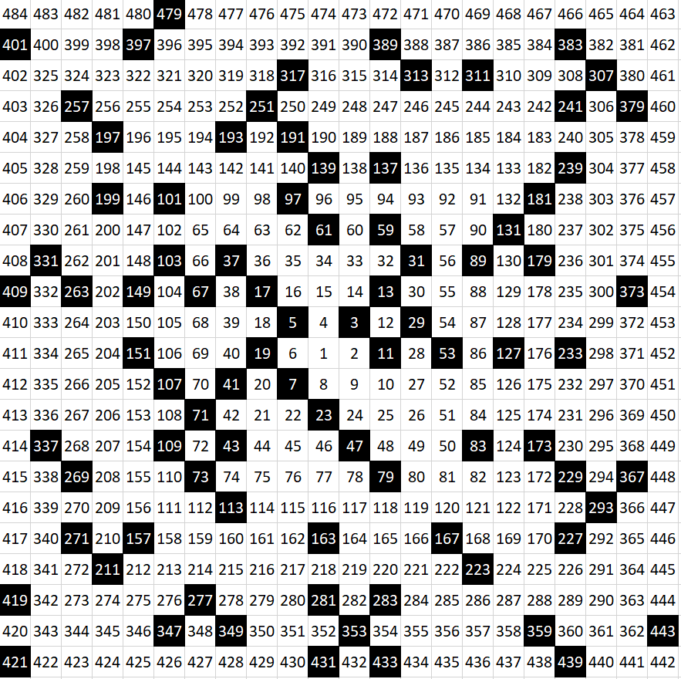
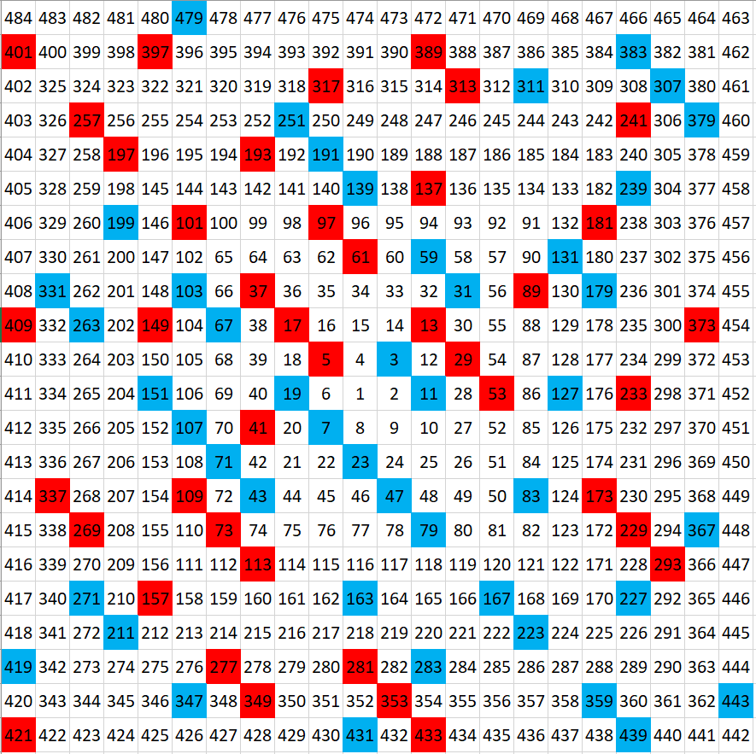

Slide 9
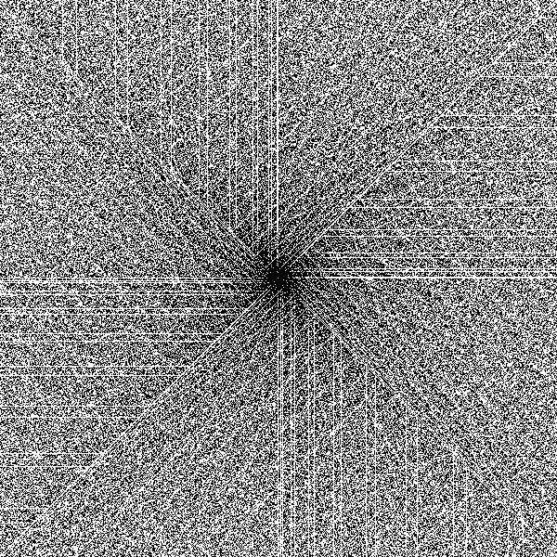

Slide 10
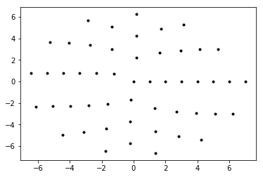
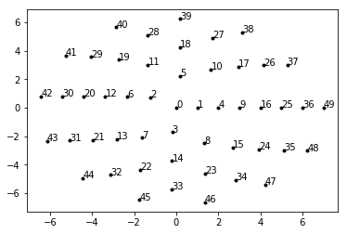
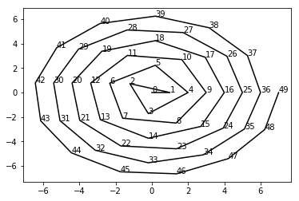

Slide 11
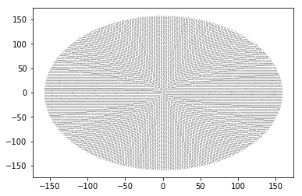
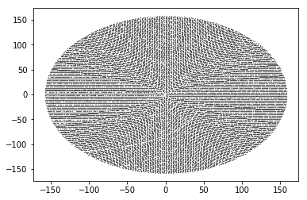
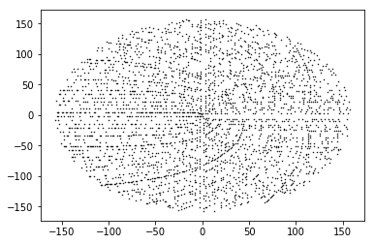
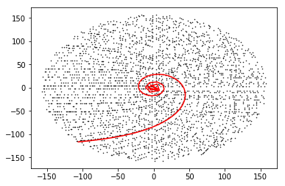

Slide 12
